Slide 1
PREDICTION OF DIABETES USING CLASSIFICATION ALGORITHMS

Slide 2
REVIEW REPORT-1
PROGRAMME: B-TECH COMPUTER SCIENCE ENGINEERING
COURSE : CSE 2004 – DATABASE MANAGEMENT SYSTEMS
SLOT : D2
FACULTY : Dr. CINU C KILIROOR
COMPONENT : J

Slide 3
TEAM MEMBERS
NAME : SANJIL KC
REGNO : 20BCE1855
NAME : LENIN VASAN
REGNO : 20BCE1892
NAME : PERAVALI SUDHEER KUMAR
REGNO : 20BPS1070

Slide 4
ABSTRACT
Diabetes Prediction System is the web based system to be used in medical field. This idea is inspired because there are lack of awareness about diabetes disease among people at this world. Diabetes can cause many worse diseases such as heart failure, nerve damage, eyes problem and another organ failure.
Next, the early diagnosis can prevent the disease become more worse. This system are build to do early diagnosis. In this system, doctors as user can predict their patients condition whether they will having the diabetes disease or not based on their records.
Next, the another user can also access this system to get early diagnosis. Then, to if they want get more accurate result, they can refer to specialists. So, this system main modules are consist of user and administrator. The user will provide the details about their health condition and personal information to get the results.
Then, the questionnaires is purposed and answers can be collected .Next, the system will provide early diagnosis result after do the calculation and generate result based on the input. The system will use rule based algorithms.
Rule based algorithm can be used for powering prediction the disease and are used to implement “IF THEN” in this system. PYTHON and SQL coding will develop into web where there is system will predict the diabetes. Also, the tips and information about Diabetes sections also available to be viewed by users. Through that, user able gain knowledge about Diabetes

Slide 5
SOFTWARE USED
PYTHON
MYSQL
SQLDBM

Slide 6
INTRODUCTION
1. DATA SET DESCRIPTION:
The dataset consists of the medical details for 768 instances which are pregnant female patients. The dataset comprises of 3 numeric value attributes which are:
Age
Plasma glucose concentration
Urine sugar level

Slide 7
OBJECTIVES
A) To measure the probability of a user for getting diabetes.
B) To implement rule based algorithm as prediction technique into a system.
C) To develop the system that function with the real problem.

Slide 8
EXPECTED OUTCOME
The system is expected to give accurate prediction based on the sign are given by user. User can answer the questionnaire based on the real signs they had. Then system will print out result of the prediction. User also able give suggestion and rate the system. This system also expected to give the accurate info which is based on the professional observation.

Slide 9
LIMITATION OF WORK
This system is only give the early prediction based on the signs that user had. The result of prediction may not accurate like the diagnosis from doctor. User need to seek consultant with doctor if want the real one diagnosis. This system just able to alert user to take fast action about the diabetes. If the user are predicted have positive diabetes, the system will give suggestion.

Slide 10
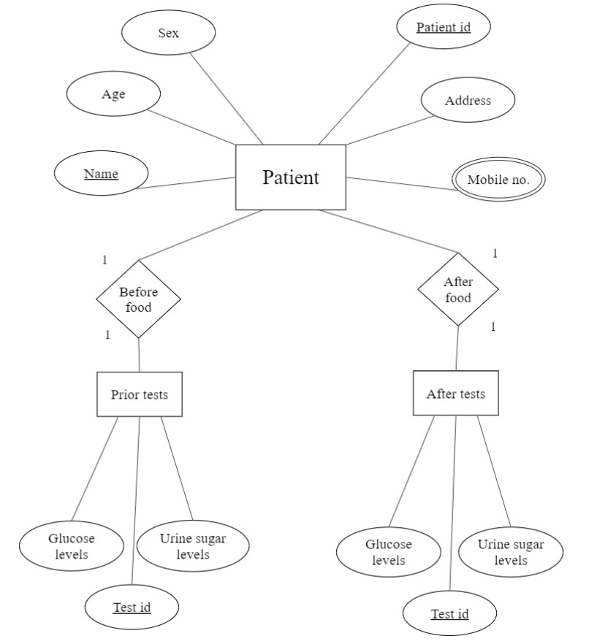
ER - DIAGRAM

Slide 11
BASIC INFORMATION
Diabetes is an ailment which influences the intensity of the body in delivering the hormone insulin, which progressively makes the digestion of sugar anomalous and lift the level of glucose inside the blood. In Diabetes an individual for the most part experiences high blood glucose. Escalate thirst, intensify hunger also, frequent pee is some of the side effects made thanks high glucose. Numerous confusions happen if diabetes stay suntreated. Some of the extreme in conveniences incorporate diabetic ketoacidos is and nonketotic hyperosmolar trance like state. Diabetes is analyzed as asignificant genuine well being matter during which the proportion of sugar substance cannot be controlled. Diabetes is not just experiencing differentelements like stature, weight, inherited factor and insulin however the significant explanation considered is sugar focus among all variables. The primary ID is that the main solution for remain away from the inconveniences.
The principal aim of the fundamental objective gathering is to machine learning model that may foresee the probability of Diabetes inside the patient sat its beginning phases with most extreme exactness reachable. As anticipating the likelihood of Diabetes fall inside the area of order issues with paired yields, we will use classification algorithms like Decision Tree, Support Vector Machine during this exploration. After the modelling of the algorithms is finished, we may test and assess our outcomes based on its exhibition measures and with acceptable outcomes, would attempt to convey the machine learning model to beutilized in real-life cases.

Slide 12
METHODOLOGY
The methodology used in the project is classification. Classification aims at identifying the category of a new observation among a set of categories on the basis of a labelled training set. By using classification, we can identify a diabetic person when there is a change in the data from the data that a non-diabetic person would have.
Algorithms used are Support Vector Machine (SVM) and Decision Tree.

Slide 13
SUPPORT VECTOR MACHINE (SVM)
SVM is one among the quality arrangement of supervised machine learning model utilized in classification. Given a two-class preparing test the purpose of a help vector machine is to locate the simplest most noteworthy edge isolating hyperplane between the 2 classes. For better generalization hyperplane ought not to lie nearer to the information focuses have an area with the opposite class. Hyperplane must be chosen which may be a great distance from the data focuses from every classification. The focuses that lie closest to the sting of the classifier are the assistance vectors.

Slide 14
DECISION TREE CLASSIFIER
Decision Tree is a supervised machine learning algorithm used to take care of order issues. The fundamental goal of utilizing Decision Tree in
this examination work is the expectation of target class utilizing choice standard taken from earlier information. It utilizes hubs and inter nodes for the forecast and arrangement. Root hubs arrange the occurrences with various highlights. Root hubs can have at least two branches while the leaf hubs speak to grouping. In each stage, Decision tree picks every hub by assessing the most elevated data gain among the properties.
The assessed execution of Decision Tree method utilizing Confusion
Matrix is as per the following:
This research is performed utilizing inner cross-approval 10-folds. Accuracy, F-Measure, Recall, Precision and ROC (Receiver Operating Curve) measures are classification of this work.

Slide 15
MODEL DIAGRAM
This figure shows the pattern of research conducted in construction model.

Slide 16
SCREENSHOT OF DATASET

Slide 17
SCREENSHOT OF DATASET

Slide 18
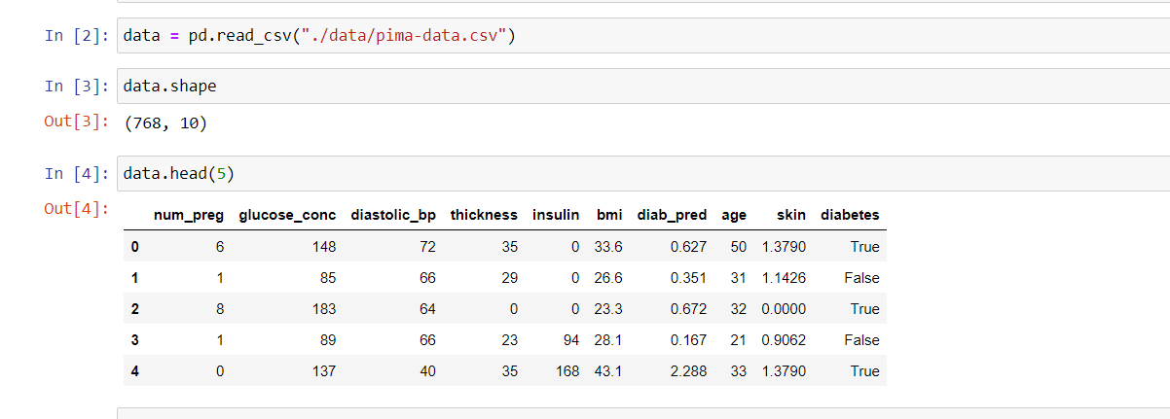
OUTPUT OF THE PROJECT

Slide 19
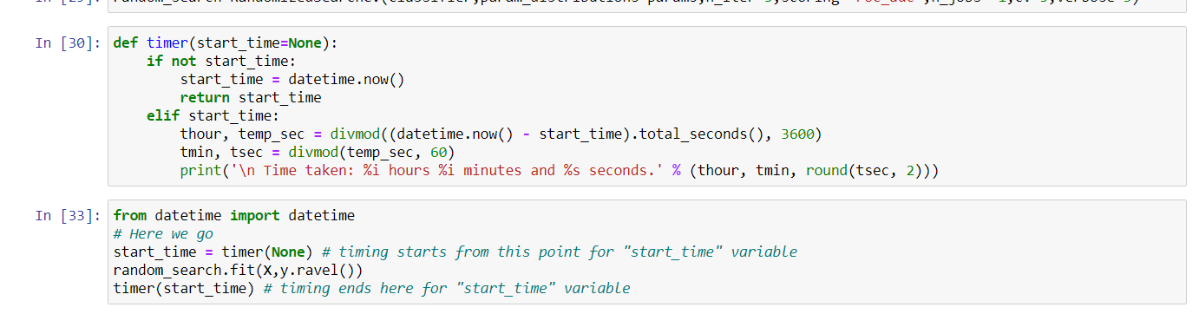
OUTPUT OF THE PROJECT

Slide 20
OUTPUT OF THE PROJECT

Slide 21
CONCLUSION
In this paper machine learning methods are used for the prediction of Diabetic Retinopathy in patients, using their health records of diabetes.
In this study we used physical health records of diabetic patients, to bring convenience along with low cost and high accuracy, as compared to traditional DR methods.

Slide 22
THANK YOU

